Slide 1


Comprehensive education for boys and girls in partnership with Simon Langton Grammar School for Boys

Slide 2
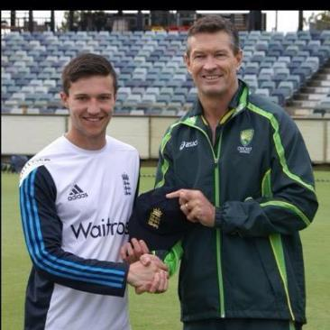
Ryan Davies
England Cricket Under 19 2015
Kent Cricket professional staff 2015
Part of Elite Sport Academy programme within Canterbury Institute of Sport receiving 14 hours of specialist coaching per week with Kent Cricket Club

Slide 3
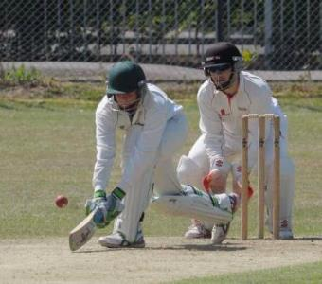
Kai Appleby
Kent Cricket Under 17 2015
Part of Elite Sport Academy programme within Canterbury Institute of Sport receiving 14 hours of specialist coaching per week

Slide 4
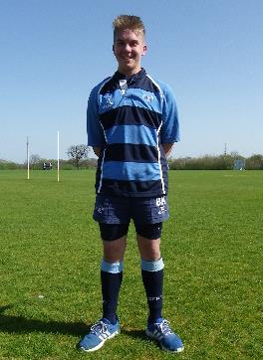
Ben King
Kent Rugby 2014
Part of Elite Athlete Support group receiving specialist programme to develop his rugby

Slide 5
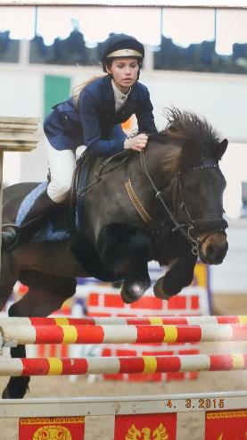
Abby Weller
Kent Show Jumping 2015
Provided with specialist funding from school to support training expenses

Slide 6
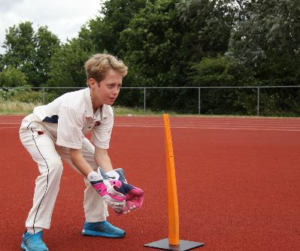
Bradley Goldsack
Kent Cricket Under 13 2015
Part of Elite Athlete Support group receiving specialist programme to develop his cricket including 1 to 1 coaching at Kent Cricket Club

Slide 7
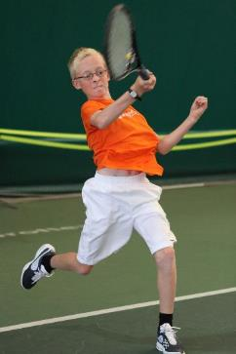
Oliver Richards
Ranked in the top 10 in Kent
Appeti Tennis School
15 – 20 hours of specialist tennis coaching per week
Part of Elite Athlete Support Group

Slide 8
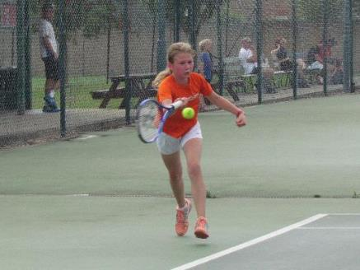
Marta Poriete
Appeti Tennis School
15 – 20 hours of specialist tennis coaching per week
Part of Elite Athlete Support Group

Slide 9
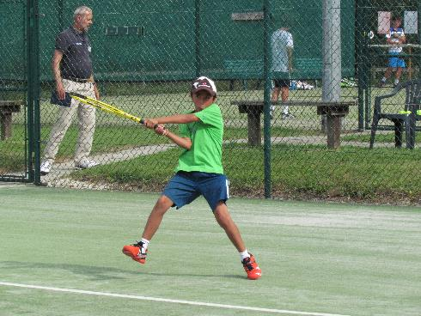
Seb McDonnell-Palomares
Appeti Tennis School
15 – 20 hours of specialist tennis coaching per week
Part of Elite Athlete Support Group

Slide 10
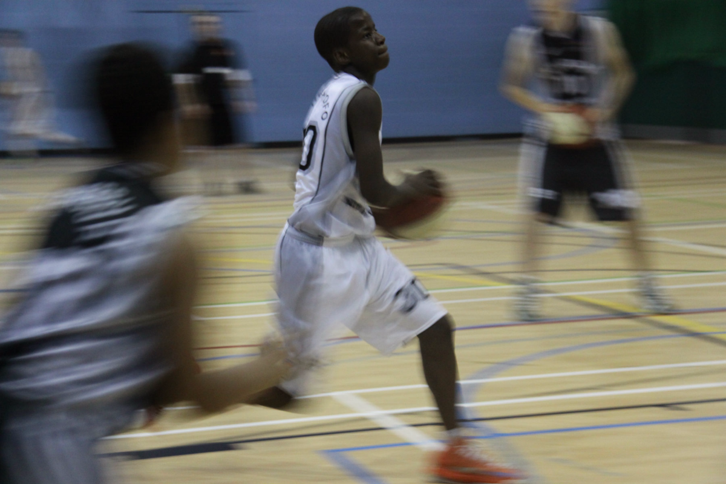
Ituah Omole
South East Region Basketball 2015
Provided with 1 to 1 specialist coaching
Involved in Kent Crusaders sixth form academy programme

Slide 11
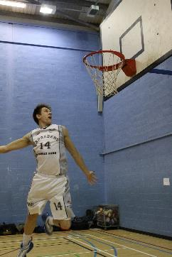
Mitchell Rae
Scotland Basketball Under 17 2014
Part of Elite Sport Academy programme within Canterbury Institute of Sport receiving 20 - 25 hours of specialist coaching per week

Slide 12
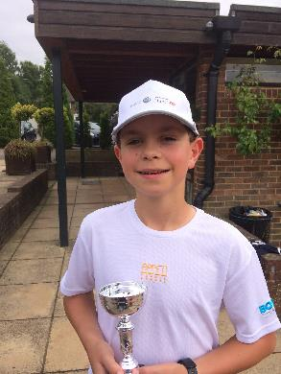
Ciaran Brewer
Ranked in the top 10 in Kent
Appeti Tennis School
15 – 20 hours of specialist tennis coaching per week
Part of Elite Athlete Support Group

Slide 13
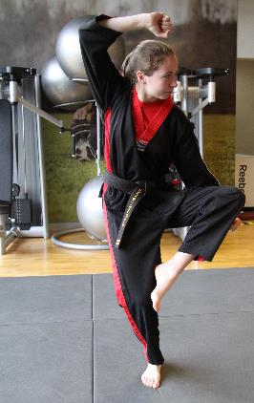
Lauren Coulthard
British Junior Karate Champion 2014
Part of Elite Athlete Support group receiving specialist programme to develop her martial arts

Slide 14
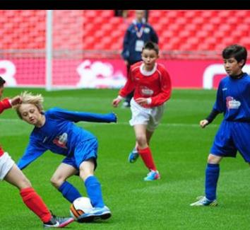
Jimmy Witt
Gillingham Football 2014
Part of Elite Athlete Support group receiving specialist programme to develop his football

Slide 15
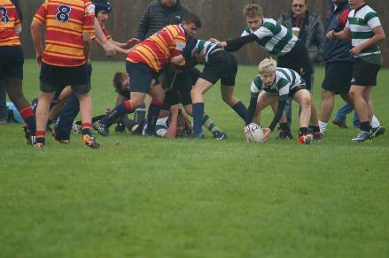
Morgan Weinel
Kent Rugby 2015
Part of Elite Athlete Support group receiving specialist programme to develop his rugby

Slide 16
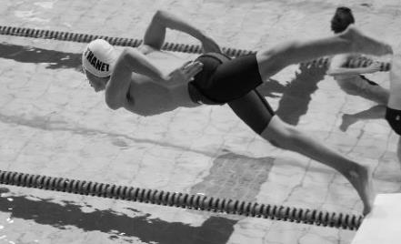
Max Jameson
England Swimming 2015
Part of Elite Athlete Support group receiving specialist programme to develop his swimming including 1 to 1 strength and conditioning

Slide 17
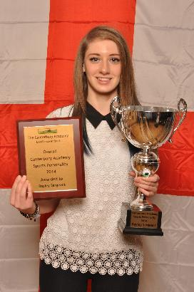
Bayley Sargeant
England Archery 2015
Provided with specialist funding from school to support training and equipment expenses
The Canterbury Academy Sports Personality of the Year 2014

Slide 18
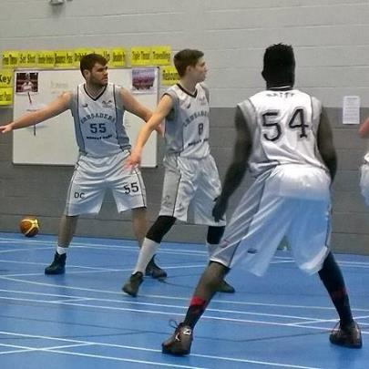
Dave Couchman
England u16 Basketball 2013
Kent Crusaders
Part of Elite Sport Academy programme within Canterbury Institute of Sport receiving 20 – 25 hours of specialist coaching per week

Slide 19
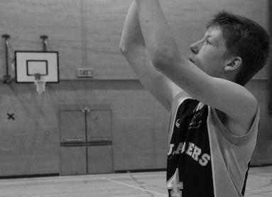
Louie Adams
South East Basketball Under 14
Part of Elite Athlete Support group receiving specialist programme to develop his basketball including 1 to 1 coaching

Slide 20
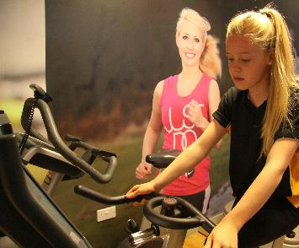
Clara Gill-Pratt
South East Regional Swimming 2015
Part of Elite Athlete Support group receiving specialist programme to develop her swimming

Slide 21
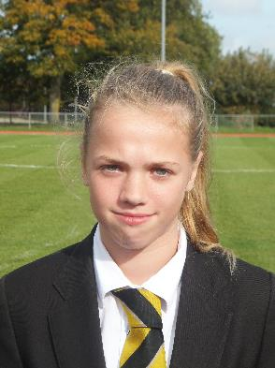
Shannon King
Kent Football 2015
Part of Elite Athlete Support group receiving specialist programme to develop her football

Slide 22
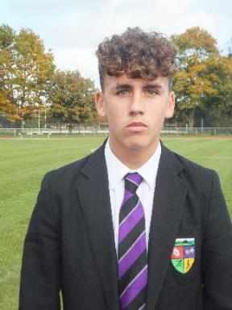
Bradley Stevenson
Gillingham Football Club 2015
Day release set up with Gillingham FC

Slide 23
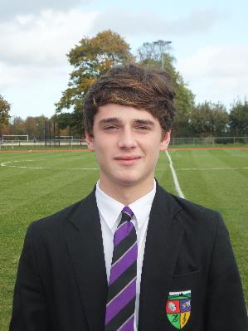
Sam Lawford
Gillingham Football Club 2015
Day release set up with Gillingham FC

Slide 24
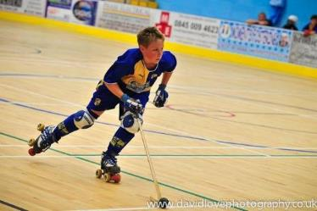
Josh Butcher
England Roller Hockey 2015
Provided with specialist funding from school to support training expenses

Slide 25
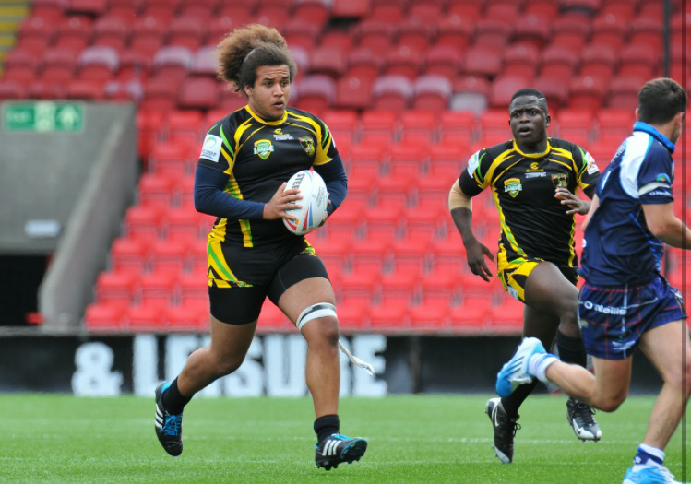
Jordan Annakie
Jamaica Rugby League Under 19
Part of Elite Sport Academy programme within Canterbury Institute of Sport receiving 10-15 hours of specialist coaching per week

Slide 26
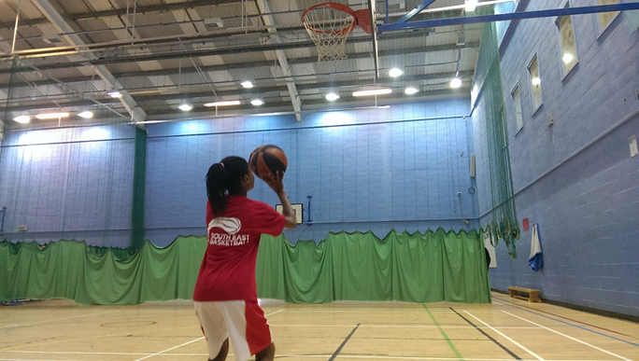
Tamara Fournillier-Onadeko
South East England Basketball
Under 13
Provided with specialist training to develop individual skills

Slide 28
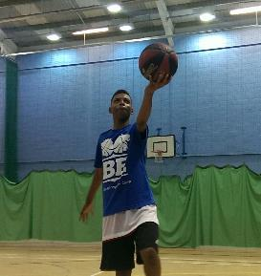
Segun Shodunke
East England Basketball
Under 13
Selected for Under 14 England training
Provided with specialist training to develop individual skills

